Slide 1
ARMY NATIONAL
GUARD
BEHAVIORAL HEALTH TRAINING EVENT
2024
"Shaping the Evolution of Behavioral Health"

Slide 2
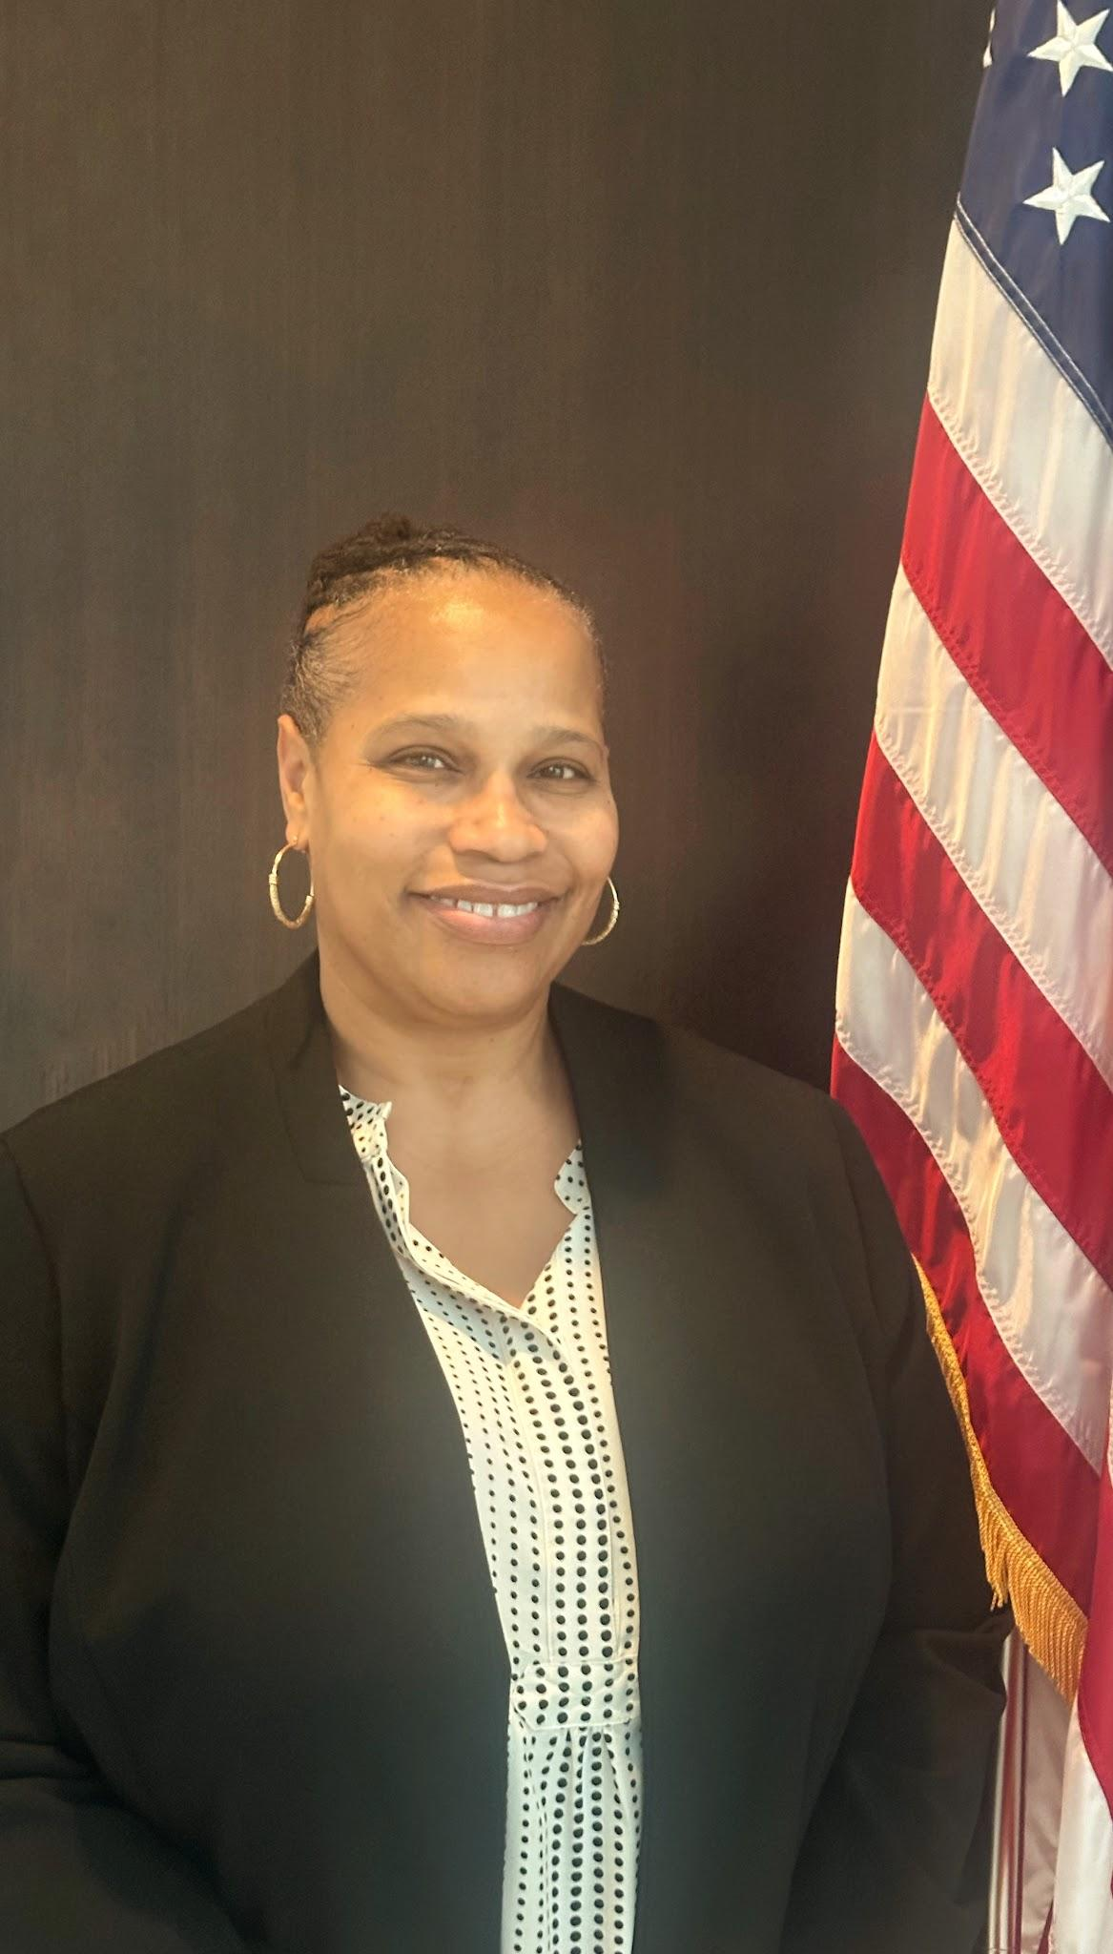
Welcome Message From the Chief, ARNG Behavioral Health Program
Ihsan S. Omar, LCSW-C, CST
Welcome to the 2024 Army National Guard Behavioral Health Training Event! This year’s theme is “Shaping the Evolution of Behavioral Health.” Our world is constantly changing, introducing new opportunities and dilemmas in the provision of mental health. Military health systems must adapt to emerging changes and be innovative to prepare for eventualities we may face.
ARNG Behavioral Health continuously strives to transform our processes and seize opportunities for strategic growth. Ongoing assessment of our clinical and administrative processes, embracing best practices, and data driven program efficacy will become cornerstones of our program to ensure purpose driven evolution of behavioral health readiness.
This year we have a wonderful training planned with knowledgeable speakers and topics targeted to enhance our clinical and administrative needs. I look forward to spending time with you all and learning about the dynamic work you are doing. Relationship building is the cornerstone of our work and I am grateful to forge a lasting relationship with all of you. I have no doubt you will leave this training with a great deal of information to enhance your ability to continue providing outstanding behavioral health services to Army National Guard soldiers and their families. I truly appreciate your commitment and dedication to serve the 54. Your efforts exemplify why we are Always Ready,…Always There.

Slide 3
Program Guide
Welcome Message … 2
Agenda ... 4 – 7
Learning Objectives (CE courses) … 8-9
Speaker Biographies … 10-15
PEC Map … 16
Accommodations Info … 17
Important Information … 18
Food Options … 19-20
Delivery Options … 21
McAlisters (Lunch) Instructions … 22
Shuttle Information … 23

Slide 4
BHTE 2024 "Shaping the Evolution of Behavioral Health"
Start | End | Duration | SUBJECT | INSTRUCTOR | LOCATION | GROUP
Day 0- Monday, 04 March 2024
 |  |  | Travel from HOR to Training Site | All attendees |  | All Attendees
17:00 | 19:00 | 2:00 | Registration/Welcome information | All attendees | Independence Hall Lobby | Optional
Day 1- Tuesday, 05 March 2024
8:00 | 8:30 | 0:30 | Opening Ceremonies, Command Welcome | COL Okpokwasili Ihsan Omar | Militia Hall, Jones Auditorium | All Attendees
8:30 | 9:00 | 0:30 | PHP Strategic Vision & Updates | Ms. Ihsan Omar | Militia Hall, Jones Auditorium | All Attendees
9:00 | 9:45 | 0:45 | BH Credentialing / Policies & DoDIs | Ms. Ihsan Omar
9:45 | 10:45 | 1:00 | Women in the Military: Considerations for Mental Health and Trauma Informed Care | LTC Amanda "Mandy" McCorkindale | Militia Hall, Jones Auditorium | All Attendees
10:45 | 11:00 | 0:15 | Break
11:00 | 12:00 | 1:00 | What an Integrated Model Looks Like: IDARNG | Ms. Susan (Bercier) Schaefer | Militia Hall, Jones Auditorium | All Attendees
12:00 | 12:45 | 0:45 | Lunch
12:45 | 14:45 | 2:00 | Lethal Means Safety / Suicide Prevention | Ms. Jennifer Nevers | Militia Hall, Jones Auditorium | All Attendees
14:45 | 15:00 | 0:15 | Break
15:00 | 17:00 | 2:00 | An Overview of Sleep and Substance Use Disorders | Dr. Diana Dolan | Militia Hall, Jones Auditorium | All Attendees
18:00 | 23:00 | - | NETWORKING SOCIAL | 323 PRESIDENT CLINTON AVE LITTLE ROCK, AR 72201 | Flying Saucer Draught Emporium | All Attendees
CE:
1.00
CE:
2.00
CE:
2.00

Slide 5
BHTE 2024 "Shaping the Evolution of Behavioral Health"
Day 2- Wednesday, 06 March 2024
8:00 | 10:00 | 2:00 | Ethics and Applications of Provider Sustainment: Implementation in Military Behavioral Health Practice | Ms. Christy Collette | Militia Hall, Jones Auditorium | All Attendees
10:00 | 10:15 | 0:15 | Break
10:15 | 11:15 | 1:00 | Ethics and Applications of Provider Sustainment: Implementation in Military Behavioral Health Practice (cont.) | Ms. Christy Collette | Militia Hall, Jones Auditorium | All Attendees
11:15 | 12:15 | 1:00 | Talent Management: To Have and to Hold | MAJ Michael Vernale | Militia Hall, Jones Auditorium | All Attendees
12:15 | 13:00 | 0:45 | Lunch
13:00 | 14:00 | 1:00 | Breakout Session 1 | Speakers Vary | Various Rooms | All Attendees
14:00 | 14:15 | 0:15 | Transition
14:15 | 15:15 | 1:00 | Breakout Session 2 | Speakers Vary | Various Rooms | All Attendees
15:15 | 15:30 | 0:15 | Break
15:30 | 16:30 | 1:00 | Sleep Survival Guide: Navigating Poor Sleep Opportunities | Dr. Diana Dolan | Militia Hall, Jones Auditorium | All Attendees
16:30 | 17:30 | 1:00 | Best Practices in Telehealth for Behavioral Health Providers | Ms. Christy Collette Ms. Jennifer Nevers | Militia Hall, Jones Auditorium | All Attendees
CE:
2.00
CE:
1.00
CE:
1.00
CE:
1.00

Slide 6
BHTE 2024 "Shaping the Evolution of Behavioral Health"
Day 3- Thursday, 07 March 2024
8:00 | 10:00 | 2:00 | Artificial Intelligence: Policy, Ethics, and Practical Considerations in Mental Health | Dr. April Foreman | Militia Hall, Jones Auditorium | All Attendees
10:00 | 10:15 | 0:15 | Break
10:15 | 11:15 | 1:00 | Artificial Intelligence: Policy, Ethics, and Practical Considerations in Mental Health (cont.) | Dr. April Foreman | Militia Hall, Jones Auditorium | All Attendees
11:15 | 12:15 | 1:00 | Psychotropics, Alternative Treatments and Deployment | LTC Rohul Amin | Militia Hall, Jones Auditorium | All Attendees
12:15 | 13:00 | 0:45 | Lunch
13:00 | 14:00 | 1:00 | Breakout Session 3 | Speakers Vary | Various Rooms | All Attendees
14:00 | 14:15 | 0:15 | Transition
14:15 | 15:15 | 1:00 | Breakout Session 4 | Speakers Vary | Various Rooms | All Attendees
15:15 | 15:30 | 0:15 | Break
15:30 | 16:30 | 1:00 | Buddy Aid / Sexual Harassment Assault Response and Prevention | MAJ Bridget Flannery | DA Selection Board Criteria | All Attendees
16:30 | 17:00 | 0:30 | Closing Remarks | Ms. Ishan Omar | Militia Hall, Jones Auditorium | All attendees
Day 5-Friday, 08 March 2024
 |  |  | Travel to HOR | All attendees |  | All attendees
CE:
2.00
CE:
1.00
CE:
1.00
CE:
1.00

Slide 7
BHTE 2024 "Shaping the Evolution of Behavioral Health“ Breakout Sessions
Session DTG--> Room # (below) | 06 Mar 1445 - 1545 | 06 Mar 1600 - 1700 | 07 Mar 0945 - 1045 | 07 Mar 1100 - 1200
230 A | Augmenting Behavioral Health Provider Training in Virtual Worlds | Augmenting Behavioral Health Provider Training in Virtual Worlds | Augmenting Behavioral Health Provider Training in Virtual Worlds | Augmenting Behavioral Health Provider Training in Virtual Worlds
 | Dr. Holloway | Dr. Holloway | Dr. Holloway | Dr. Holloway
Emcee | LTC Leah Fletcher | LTC Leah Fletcher | LTC Leah Fletcher | LTC Leah Fletcher
230 C |  |  | Cracking the Code of Sleep Log Patterns | Diversity Model / Transgender Integration Panel
 | 1LT Jesse James |  | Dr. Diana Dolan | Ms. Naya Clifford Ms. Robin Sontheimer Ms. Bryson Bower
Emcee | Ms. Rita Baldonado | Ms. Rita Baldonado | Ms. Rita Baldonado | Ms. Rita Baldonado
227 | Embedded Behavioral Health Officers: Drill Weekend Best Practice | BHO in PHAs | DHA use of 68Xs | DA Selection Board Criteria: Promotion Guidance and Career Development for AMEDD Officers
 | CPT Sarah Skelton | Ms. Fameika Thomas | LTC Fleming SSG Beadie Ms. Tara Pushkin 1LT Jesse James | MAJ Bobbi Blakley
Emcee | Ms. Angela Brooks-Green | Ms. Angela Brooks-Green | Ms. Angela Brooks-Green | Ms. Angela Brooks-Green
103 | Yoga and MH | Tai-Chi | Yoga and MH | Tai-Chi
 | Ms. Carrie "Beth" Anderson | Ms. Cynthia Frusha | Ms. Carrie "Beth" Anderson | Ms. Cynthia Frusha
Emcee | Ms. Devinn Searfass | Ms. Devinn Searfass | Ms. Devinn Searfass | Ms. Devinn Searfass
115 | Wellness Room | Wellness Room | Wellness Room | Wellness Room
 | LTC Atkins C. Barrett | LTC Atkins C. Barrett | LTC Atkins C. Barrett | LTC Atkins C. Barrett
BH Management: TNARNG’s efforts to address underutilization of uniformed National Guard BH assets (BHO/68X)

Slide 8
Session Learning Objectives
Women in the Military: Considerations for Mental Health and Trauma Informed Care
Over the past few years, DoD and VA have invested in better understanding women who choose to serve in the military and their unique needs. An overview of the research related to this growing population will be presented, and statistics related to pre-military, adverse childhood experiences will be described. Finally, specific guidance on the delivery of trauma-informed care will be discussed as well as services offered for women through the VHA. Attendees will better understand the demographics of women who serve in the military and their unique needs, link the complexity of mental health presentations seen in women who serve to the role that adverse childhood experiences play in their mental health and learn to provide trauma-informed communication and behavioral strategies for medical and mental health providers.
Conducting Lethal Means Safety Counseling with Military-Connected Clients
This 120-minute training provides behavioral health providers with research-based information about the principles of lethal means safety counseling. It begins by exploring the importance of discussing means as part of suicide prevention interventions. Next, population-level efforts are compared with individual-level initiatives. Key components of Lethal Means Safety Counseling using principles of Motivational Interviewing are explored in depth. Participants view a video of Means Safety Counseling and then are provided with an opportunity to engage in a role play to practice skills introduced. The presentation concludes with an overview of suggested resources for additional learning.
An Overview of Sleep and Substance Use Disorders
This session will focus on evaluating the relationship between sleep disorders and substance use pathology and applying appropriate screeners to the stratification of sleep and substance related disorders. This session will also provide a overview of Sleep & Substance Use Disorders. Discussion includes: the prevalence of problematic sleep & substance use, how Sleep and Substance Use Disorders impact each other and screening & referral recommendations. Participants will learn to evaluate the relationship between sleep disorders and substance use pathology as well as apply appropriate screeners to the stratification of sleep and substance related disorders.
Ethics and Applications of Provider Sustainment:
Implementation in Military Behavioral Health Practice
This three-hour training will focus on provider self-care and will help identify three areas to explore as providers create a personalized plan. The course will analyze the importance of sustainment as a way of reducing or eliminating burnout in behavioral health providers. A discussion of the most recent updates to professional codes of ethics and their role in maintaining a provider’s personal and professional fitness will be presented in the context of behavioral health practitioners working with military-connected clients. Available self- assessment tools will be reviewed and appropriate uses for each discussed. Attendees will begin to develop a sustainment plan that includes personal, professional, and organizational strategies. This workshop is designed for mental health professionals and trainees.
Page 8

Slide 9
Session Learning Objectives
Sleep Survival Guide: Navigating Poor Sleep Opportunities
This session will include training on Differentiating Sleep Ability vs Opportunity, Impact of Reduced Sleep Opportunity and first steps to increasing sleep opportunities. Survival Guidance and Case Examples will be reviewed. Participants will learn to recognize the signs of sleep deprivation and implement strategies for managing poor sleep opportunities.
Best Practices in Telehealth for Behavioral Health Providers
This one hour session will cover current research on telehealth in behavioral health settings as well as discuss best practices. Attendees will receive practical suggestions and handouts for use in conducting telehealth. Participants will review best practices for engaging in telehealth for behavioral health providers and analyze research on efficacy of telehealth on multiple behavioral health diagnoses.
Artificial Intelligence: Policy, Ethics, and Practical Considerations in Mental Health
This session will review the “Two Future Visions” of Artificial Intelligence (AI), basic concepts about AI/ML/NLP, how Psychologists will play a role in the future of AI/ML/NLP work, fascinating ethical dilemmas and interesting use cases that will be impactful. Participants will evaluate three unique affordances of virtual worlds platforms to enhance provider training and distinguish between two models of virtual learning, identifying the pros and cons of each.
Psychotropics, Alternative Treatments and Deployment
The initial section of the presentation will address current guidelines from CENTCOM and PACOM related to which Soldiers need waivers and what psychotropics and psychiatric conditions are likely to be denied a waiver. The session will also include a review of an algorithm of when to submit a patient with psychiatric disorders for medical board, compare and contrast how therapy compares with medications. This will help the learners better understand when to consider referring patients for medications. Participants will learn to describe the current COCOM guidance on psychotropic use and pre-deployment requirements, compare and contrast the effect sizes of psychiatric medications vs. psychotherapy for depression, anxiety and PTSD and demonstrate common deployment-related presentations and management.
Buddy Aid
Participants will recognize how an operationalized approach, (tactical language, humor and non-standard intake techniques) destigmatizes conversations around psychological trauma and elevates understanding of the threat of corrosives like Sexual Assault. Participants will demonstrate the Buddy Aid toolkit, experimenting with both the what (content) and the how (nonverbal and para-language) of Buddy Aid statements, normalizing phrases and reflections. Participants will examine military-specific barriers to disclosures and how Buddy Aid principles contribute to mitigating them.

Slide 10
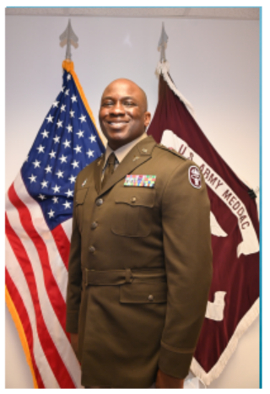
SPEAKER BIOGRAPHY
COL. Nkemakonam Okpokwasili; Chief Surgeon ARNG is the Chief Surgeon for the Army National Guard. He was born and raised in The Bronx, New York, the son of Nigerian immigrants. He is a graduate of Columbia University in New York City, from which he earned a Bachelor of Arts degree in History and Sociology. He holds a Masters of Science degree in Cellular and Molecular Biology from the University of New Haven, Connecticut, and a Doctor of Osteopathy degree from the University of Medicine and Dentistry of New Jersey. His military education includes the Army Medical Officer Basic and Advanced Courses, the Brigade Surgeon Course, the Division Surgeon Course, Command and General Staff Officer’s Course, and a Masters of Strategy from the Army War College.
Colonel Okpokwasili's significant assignments include service as a General Medical Officer for General Surgery, Landstuhl Regional Medical Center; the 41st Fires Brigade Surgeon during Operation Iraqi Freedom; the 31st Air Defense Artillery Brigade Surgeon; Chief of Primary Care Services, The National Training Center, Fort Irwin, CA; Division Surgeon for 2nd Infantry Division/ROK-US Combined Division; and Deputy Commander of Clinical Services of the Fort George G. Meade MEDDAC.
Colonel Okpokwasili's overseas experience comprises multiple overseas tours, including a deployment to Iraq.
His awards and decorations include the Bronze Star Medal, the Meritorious Service Medal (with 5 Oak Leaf Clusters), the Army Commendation Medal (with 1 Bronze Oak Leaf Cluster), and the Joint Service Achievement Medal.
Dr. Okpokwasili is a member of the Order Of Military Medical Merit and is a Fellow of the American Association of Family Physicians.
Colonel Okpokwasili is married and has five wonderful children.

Slide 11
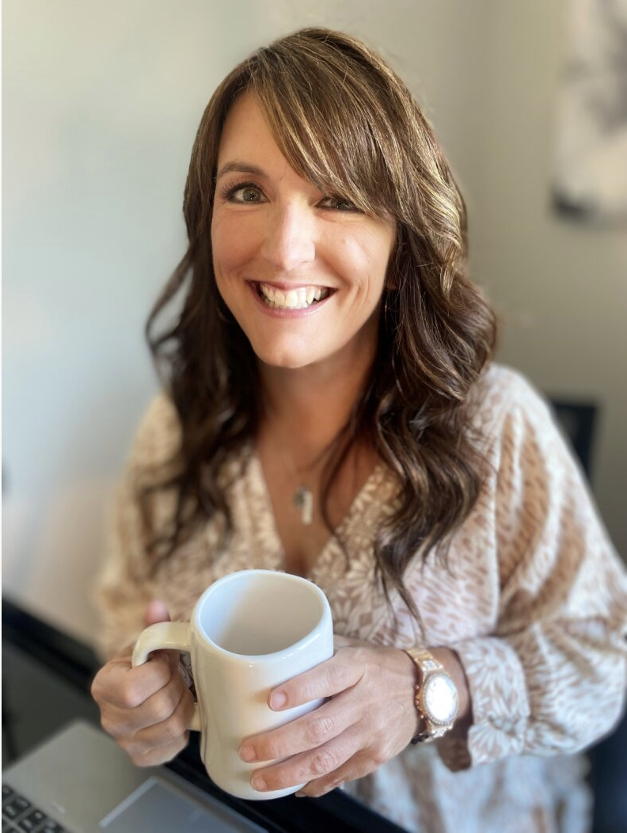
SPEAKER BIOGRAPHY
Mandy McCorkindale, Psy.D., ABPP is a licensed clinical psychologist and a board-certified clinical health psychologist who is currently working as the Women's Health Psychologist at the Veterans Healthcare System of the Ozarks in Fayetteville, Arkansas. Dr. McCorkindale is enjoying being back in direct patient care after seven years in management and administration with the Central Arkansas Veterans Healthcare System where she served as the Chief Psychologist and prior to that, the Program Manager for the Primary Care Behavioral Health program. Dr. McCorkindale is an Air Force Veteran and completed her doctoral internship at Lackland Air Force Base in San Antonio, Texas. After her four years of active-duty service, she joined the Arkansas Army National Guard where she became the first psychologist in the AR ARNG.
Dr. McCorkindale is an Aeromedical Psychologist and is currently attached to the 77th Theater Aviation Brigade at Camp Robinson. Dr. McCorkindale is certified in three evidence-based trauma treatment protocols and has been a training consultant for the Prolonged Exposure in Primary Care training program within VA. As a health psychologist, her work focuses on treating the whole person and helping her patients to improve their functioning in order to live out their values.
Susan (Bercier) Schaefer With over two decades of dedicated service in mental health, Suzi brings a wealth of experience from both the private and public sectors. Her journey began working with patients in an outpatient mental health setting which eventually led her into opening her own private practice, working with kids, adults, couples, and groups. While practicing, she also took on contract work for the military working in both domestic violence and mental health. She eventually transitioned full time to the Air Force as a mental health provider with Task Force True North, while still maintaining part time private practice. After relocating to Idaho, she became the Director of Psychological Health for the Idaho Army National Guard. Suzi’s focus and commitment through her years as a mental health provider has been to foster well-being and resilience with her clients, advocating for systematic growth and change, program development and implementation, and increasing awareness and access to services, specifically through the military. She has trained in TF-CBT, DBT, PE, to name a few. Her passion lies within her service to others and she continues to work to reduce the stigma of mental health and increase accessibility to services.

Slide 12
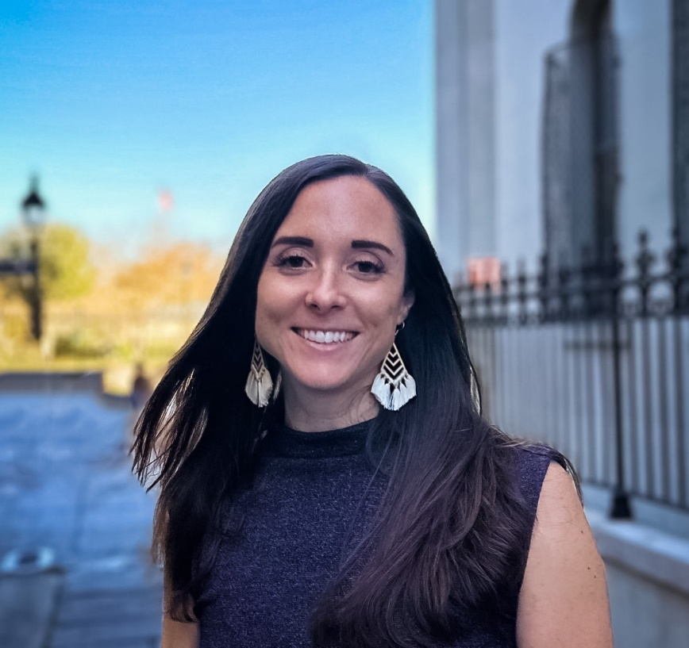
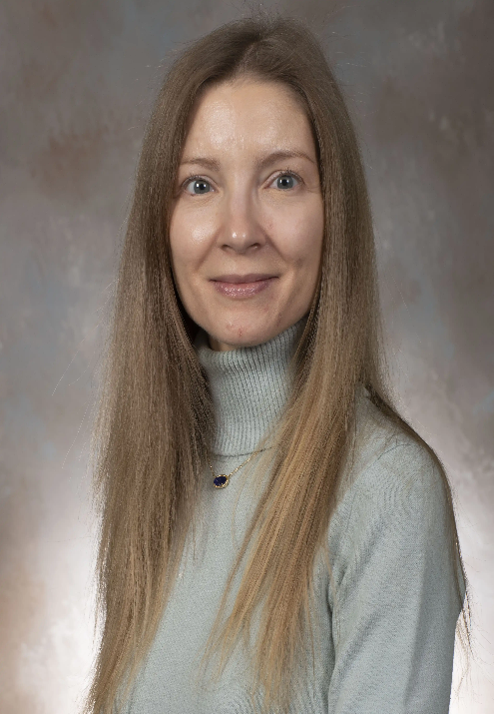
SPEAKER BIOGRAPHY
Jennifer Nevers, MSW, LCSW, is a Military Behavioral Health Social Worker with the Center for Deployment Psychology (CDP) at the Uniformed Services University of the Health Sciences (USUHS) in Bethesda, Maryland. She assists in the implementation and national expansion of the Star Behavioral Health Providers (SBHP) Program. SBHP trains civilian behavioral health providers to work with Service members, veterans, and their families. The mission is to expand the availability of high-quality behavioral health services, especially to those in the Reserve Components.
Jennifer is a Major in the Indiana Army National Guard serving as a Behavioral Health Oﬃcer with the 738th Medical Company Area Support. Jennifer interfaces with Service members across Indiana linking National Guard Soldiers to behavioral health services. Prior to joining CDP, Jennifer worked with the U.S. Department of Veterans Aﬀairs in the Veterans Justice Outreach Program. Jennifer has over 10 years’ experience working as a liaison with problem solving courts and increasing access to care for justice-involved Veterans.
Jennifer received her Bachelor of Social Work from Indiana University in 2008 and her Master of Social Work from Washington University in St. Louis in 2009. Jennifer specializes in addressing the unique needs of Service members and veterans using evidence-based approaches. Jennifer is certiﬁed in Cognitive Processing Therapy, an evidence-based treatment for PTSD and trauma-related disorders.
Diana C. Dolan, Ph.D., CBSM, DBSM, is a clinical psychologist serving as an Assistant Director of Training & Education with the Center for Deployment Psychology at the Uniformed Services University of the Health Sciences in Bethesda, Maryland. She currently oversees the Star Behavioral Health Providers (SBHP) team at CDP, which is an NGB-funded training and registry program to prepare civilian community providers to work with National Guard members. She also develops and presents evidence-based training for military-connected patients on a variety of topics, and provides consultation services
Dr. Dolan graduated from the University of North Texas with a bachelor’s degree in psychology and earned her doctorate in clinical health psychology and behavioral medicine from the University of North Texas. She completed a clinical psychology internship at Wilford Hall Ambulatory Surgical Center in San Antonio, Texas. Dr. Dolan served as an active duty psychologist and is a veteran of the U.S. Air Force.
Dr. Dolan’s professional interests include behavioral treatment of health conditions, in particular sleep disorders and within brief-natured primary care settings, clinical psychology training and program evaluation, and military psychology. She is certified in Behavioral Sleep Medicine by the American Board of Sleep Medicine. She is also a diplomate in Behavioral Sleep Medicine from the Board of Behavioral Sleep Medicine

Slide 13
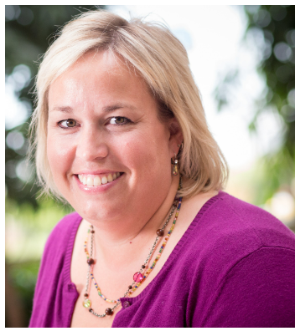
SPEAKER BIOGRAPHY
Christy Collette is a Military Behavioral Health Counselor for the Center for Deployment Psychology at the Uniformed Services University of the Health Sciences in Bethesda, Maryland. In this capacity, she assists in the national expansion of the Star Behavioral Health Providers (SBHP). SBHP is a training and registry program with a mission of increasing access to high quality behavioral health services to the military-connected population, especially to those in the National Guard. Christy serves as a faculty member and teaches workshops on a variety of topics including, Assessment and Management of Suicide in the Military, Provider Sustainment, and working with Military Families. She also trains a series of workshops specific to working with military couples.
Prior to coming to CDP, Christy worked at the Military Family Research Institute at Purdue University. In this capacity, she worked on the SBHP program and implemented the program in new states. In her role at MFRI, Christy sat on the Executive Committee for Joining Community Forces Indiana and worked to coordinate resources across the state of Indiana.
Christy Collette, LMHC | Center for Deployment Psychology
Christy received her bachelor’s and master’s degrees from Ball State University. She is a licensed mental health counselor with experience in community mental health and private practice. She currently maintains a small private practice and works as a crisis clinician at a local hospital. Christy has over 15 years’ experience working with children through play therapy and has worked extensively with military families.
Major Michael A. Vernale is the Wing Psychologist for the 70th Intelligence, Surveillance, and Reconnaissance Wing (70 ISRW), Air Combat Command (ACC), Fort George G. Meade, Maryland. In this role, he is the senior and supervisory Psychologist and serves as subject matter consultant for 70th ISRW Commander on the full range of behavioral health products and services employed by unit personnel and their families. His primary role is to establish Wing-level awareness, advocacy, and synchronization of psychological capabilities and resiliency policy initiatives provided to over 6000 personnel assigned to five groups, eighteen squadrons, and two detachments spanning twenty-eight locations worldwide.
Major Vernale received a direct commission into the USAF in July 2012, completing his Clinical Psychology Residency at Malcolm Grow Medical Center, Joint Base Andrews AFB, MD, in 2013. He is a licensed Clinical Psychologist. He is fellowship trained in Combat Operational Psychology. Prior to his current assignment he served in a variety of positions including SGB, Mental Health Flight Commander, Family Advocacy Officer in Charge, Alcohol Drug and Prevention Officer in Charge, and Director of Psychological Health, and Chief Psychological Applications. Most recently, as Wing Director of Talent Management and Assessments at 70th ISRW, Ft Meade, MD he provided oversight for all psychological assessment, training, support and consultation services for Airmen and Commanders.
Maj Vernale has deployed in support of contingency operations in Operation Enduring Freedom/Joint Task Force Jordan.
EDUCATION
2003 B. S. Psychology and Business, University of Arizona, Tucson, AZ
2010 M. S. Clinical Psychology, Illinois Institute of Technology, Chicago, IL
2012 Clinical Psychology Residency, Malcolm Grow Medical Center, Joint Base Andrews, MD
2013 Phd. Clinical Psychology, Illinois Institute of Technology, Chicago, IL
ABD Psychopharmacology, Fairleigh Dickenson University, New Jersey
AFSOC Combat Operational Psychology Fellowship

Slide 14
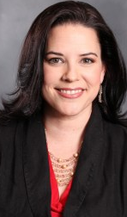
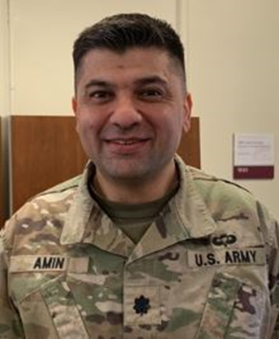
SPEAKER BIOGRAPHY
April C. Foreman, Ph.D., is a Licensed Psychologist serving Veterans as Deputy Director of Technology and Innovations for the Veterans Crisis Line. She is a member of the team that launched OurDataHelps.org, a recognized innovation in data donation for ground-breaking suicide research. She is passionate about helping people with severe (sometimes lethal) emotional pain, and in particular advocates for people with Borderline Personality Disorder, which has one of the highest mortality rates of all mental illnesses. She is known for her work at the intersection of technology, social media, and mental health, with nationally recognized implementations of innovations in the use of technology and mood tracking. She is the 2015 recipient of the Roger J. Tierney Award for her work as a founder and moderator of the first sponsored regular mental health chat on Twitter, the weekly Suicide Prevention Social Media chat (#SPSM, sponsored by the American Association of Suicidology, AAS). Her dream is to use her unique skills and vision to build a mental health system effectively and elegantly designed to serve the people who need it.
LTC Rohul Amin, MD, is currently the Director of Graduate Medical Education at Walter Reed National Military Medical Center. He is a Marine Corps veteran who received his MD degree from the Uniformed Services University, and then did the combined psychiatry and internal medicine residency training at Walter Reed. He has
previously served as the Program Director for the psychiatry residency program at Walter Reed. Other experiences have included serving as
the medical director of the inpatient addiction unit at Fort Belvoir, and
the 7th ID division psychiatrist. He enjoys curriculum development and
teaching including medical readiness topics, suicide prevention, and the medical care of psychiatric patients.

Slide 15
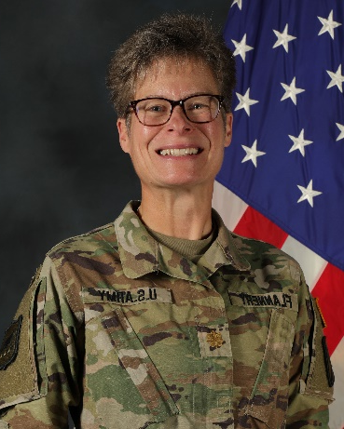
SPEAKER BIOGRAPHY
MAJ Bridget Flannery, Buddy Aid Program Manager, NGB has served as a Unit Victim Advocate for 18 years, both as an NCO, while a squad leader in a transportation company, and after accepting a direct commission in military intelligence. She deployed as a tactical intelligence officer while a UVA, and this experience in a highly kinetic area of operations shaped her advocacy. Flannery operationalized the fight against sexual assault, and within her battalion in Afghanistan, sexual assault came to be treated like all other kinetic threats, resulting in increased reporting – and fewer Victims facing their violence alone. Upon demobilization in 2013, Flannery continued the operationalization efforts at home, drafting training in first response to sexual assault, Buddy Aid. Mental health professionals specializing in MST validated the training in 2014, and again in 2017 and 2019. Flannery trained SD units and multiple Regional Training Institute classes in Buddy Aid, impacting ARNG units nationwide, and supporting countless Victims in their journeys. In 2019, the Warrior Resilience and Fitness Innovation Incubator selected Buddy Aid as one of six inaugural projects, allowing Flannery to prepare Soldiers and Airmen across the country to train Buddy Aid to their formations. In 2020, Flannery received the Excellence in Prevention Award from DoD for her work with Buddy Aid. In 2021, Buddy Aid was stood up at the ARNG’s Professional Education Center in North Little Rock, AR, and in 2023, NGB brought Buddy Aid to J1 SAPR, where Flannery now serves as Program Manager.
Flannery began her military career as a truck driver with the 1742nd Transportation Company in Flandreau, SD in 1987. She served in Operation Desert Storm, and returned to civilian life 1993. In 2006, Flannery re-enlisted, serving as squad leader in the 1742nd until accepting a direct commission in military intelligence in 2010. She was assigned to the 152nd CSSB in Pierre, SD, serving with distinction as Battalion S2 until 2014. Following her work with the 152nd in Afghanistan, Flannery was invited to brief the G1 section of General Frank Grass’s staff on her efforts in the fight against sexual assault, and was awarded the Colonel Carl F. Eifler award for her work in intelligence. She subsequently served in various staff positions in the SDARNG: PA Officer and Commander of the 129th MPAD; S4 at the 139th BSB; and as the Tactical Intelligence Officer for the 109th Regional Support Group.
With over 25 years in the field of education, Flannery brings a unique training perspective to her military assignments. In the public sector, she has just under a decade of teaching experience at the post-secondary level at both university and technical institutes. She’s also served in both middle-school and high-school assignments. Her facilitation experience in nearly 15 years of private sector service made her a leader in conflicts arising from diversity challenges. Serving as Site Manager in both South Dakota and Puerto Rico, her skill in analyzing operational data to identify opportunities for improvement contributed greatly to her sites’ success.
Flannery volunteers in her parish and her son’s school and is commander of VFW Post 3351.
A native of Montrose, South Dakota, Flannery received her BA from South Dakota State University in 1987 and completed the coursework for her Masters there in 1993. Her studies focused on English, Spanish, Philosophy and Linguistics.
Flannery has lived in Flandreau, SD since demobilizing from Operation Desert Storm in 1991. Her husband, Randy Tollefson, is a retired Guardsman, and they share their farm with their youngest son, Titus, a seventh-grader, and two faithful dogs. They have 2 older children, Chelsey and Caleb, a daughter-in-law, a son-in-law, three grandsons, a granddaughter, and one blessed life.

Slide 16
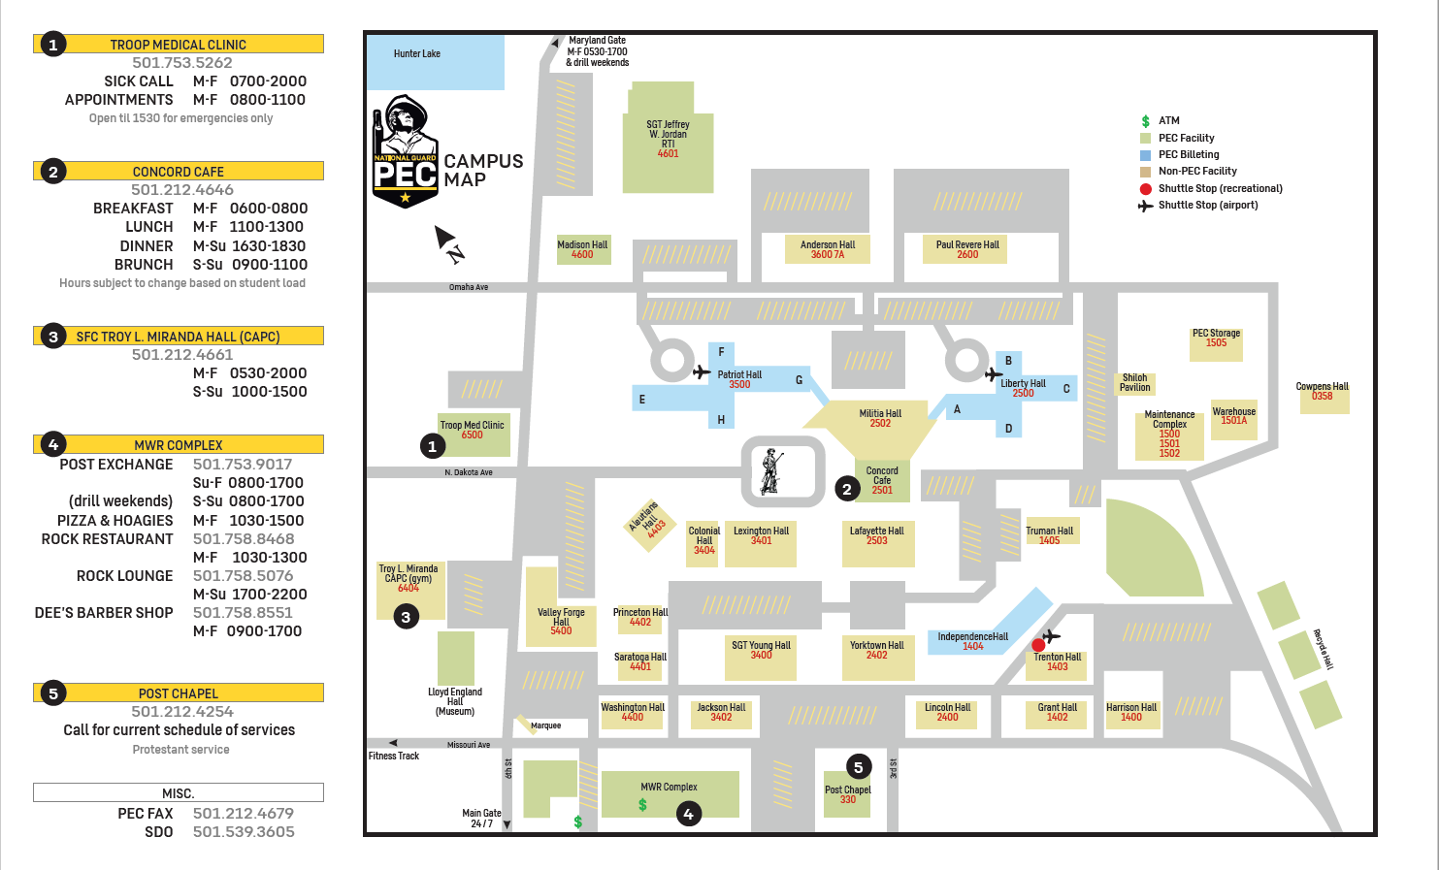
CLOSED
Notes:
Restaurants that deliver
Shuttle information

Slide 17
Accommodations Info
LODGING
Lodging is automatically reserved for registered attendees. Rooms are single occupancy, have private bathrooms, and are furnished with a bed, desk, chair, TV, refrigerator, iron, ironing board, and wireless internet. Towels and washcloths are provided daily; bed linen service is weekly. Laundry is available at no cost. Firearms, cooking, tobacco use, and vaping in rooms are prohibited.
SPECIAL ACCOMMODATIONS
Handicap-accessible rooms are available. The Nursing Mothers Room located in Independence Hall is equipped with a full-size refrigerator/freezer and a recliner to provide a comfortable and discrete location for mother's to both express and store their breast milk.
PHYSICAL FITNESS FACILITY
The SFC Troy L. Miranda Combat Athletic Performance Center (CAPC) is open weekdays, 0530 to 1830; and weekends, 1000-1400.
AUTHORIZED TRANSPORTATION
PEC provides transportation from Clinton National Airport (LIT), TAC Air, and Little Rock Air Force Base to PEC. Pick-up at LIT is at the covered island adjacent to the baggage claim area at the airport. PEC provides transportation until the last scheduled flight arrival time for that day. In the event of a flight delay, it is the attendee’s responsibility to obtain commercial transportation (taxi, Uber, Lyft) from the airport to Independence Hall on Camp Robinson. Ensure the driver can access the installation; drop off at the main gate is not authorized.
PEC Portal, https://pec.ng.mil
Important Numbers:
PEC Registration 501-212-4700
Post Security 501-212-5280
Staff Duty 501-539-3605
Chaplain 501-413-3765
SARC 501-554-4810

Slide 18
Important Information
LANDING FEE
EXACTLY $30 is due at registration. Please have exact change.
UNIFORM
Duty uniform for military personnel is the Army Combat Uniform in Operational Camouflage Pattern. DA Civilians and contractors wear "business casual" attire.
UNAUTHORIZED TRANSPORTATION
Rental vehicles are not authorized.
DTS TRAVEL AUTHORIZATION NUMBER
Located in the bottom right hand corner of the DTS Approval Letter DD 1610/ Should be a 5-6 Alphanumeric Code. Be sure to bring your DTS Travel Authorization Code as it is a requirement for registration
PEC Portal: https://pec.ng.mil
Title Number
Registration 501-212-4700
Post Security 501-212-5280
Staff Duty 501-539-3605
Chaplain 501-413-3765
SARC 501-554-4810

Slide 19
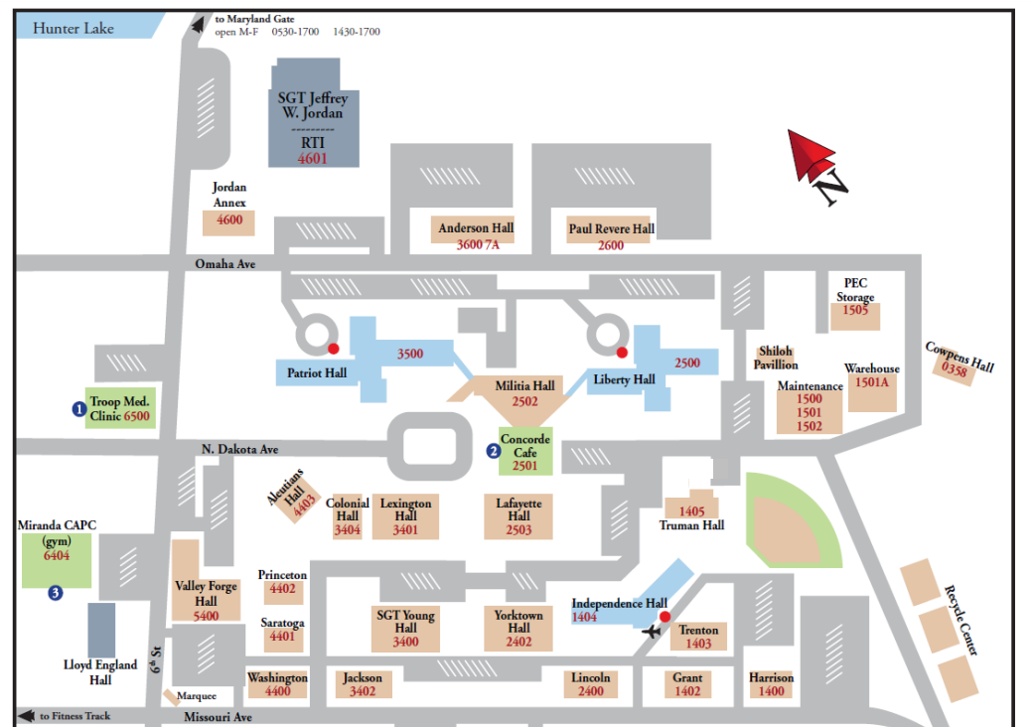
Food Options - Breakfast
2
1
3
1: Coffee Coop
2: Banada Burger
3: Grab and Go / Latte Machine

Slide 20
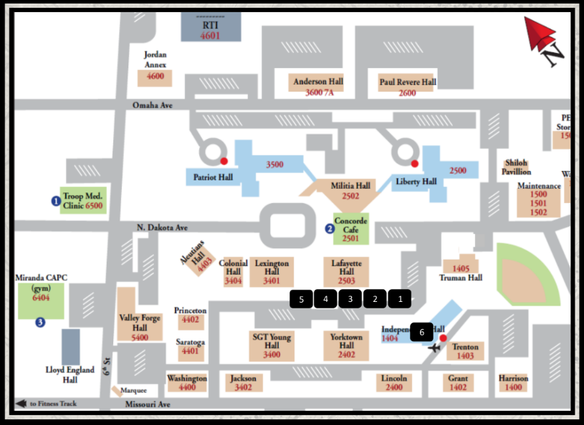
Food Options - Lunch
1: Coffee Coop
2: Banada Burger
3: Hibachill
4. Top Dog
5. North Bar Mobile (Pending)
6. Grab and Go – Latte Machine

Slide 21
Delivery Options -On Post Access
The following restaurants deliver to Independence Hall (Lodging) located at 1404 Missouri Ave. Little Rock, AR 72199
Great Wall Chinese Cuisine
https://greatwallar.com/
501-753-3316
Papa Johns
(501) 791-0505
Domino's Pizza
(501) 834-2600

Slide 22
McAlister’s Deli https://www.mcalistersdeli.com/
Special Instructions:
CODE: “BHTE”
FIRST and LAST Name
Tuesday Pick-up Time: 1115
Wednesday Pick-up Time: 1130
Thursday Pick-up Time: 1130
4842 North Hills Boulevard, North Little Rock, AR 72116
*Orders must be placed BEFORE 0930 each morning, if you would like BHTE PC to pick-up! Please, do NOT order a drink.
See BHTE Planning Committee Member in THIS T-SHIRT to record your order!
Orders must be placed individually online

Slide 23
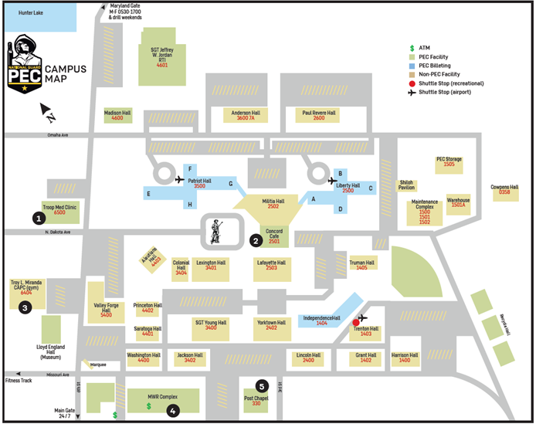
Shuttle Information
Walmart Shuttle
Sunday: 1830; 2000
Monday: 1730; 1900; 2030
Wednesday: 1730; 1900; 2030
DOWNTOWN Shuttle - Tuesday through Friday
*IND Hall: 1730; 1930; 2130
Argenta: 1745; 1945; 2145; 2300
State House: 1747; 1947; 2147; 2302
Main Street: 1750; 1950; 2150; 2305
*TIMES TO LEAVE PEC ARE FROM INDEPENDENCE HALL ONLY DROP OFF/PICK UP TIMES MAY VARY A FEW MINUTES DUE TO TRAFFIC DROP OFF AND PICK UP LOCATIONS ARE THE SAME
A dedicated SHUTTLE will be provided for those attending the NETWORKING SOCIAL

